Slide 1
Operators in C
Department of Computer Science and Engineering,
Chitkara University, Punjab

Slide 2
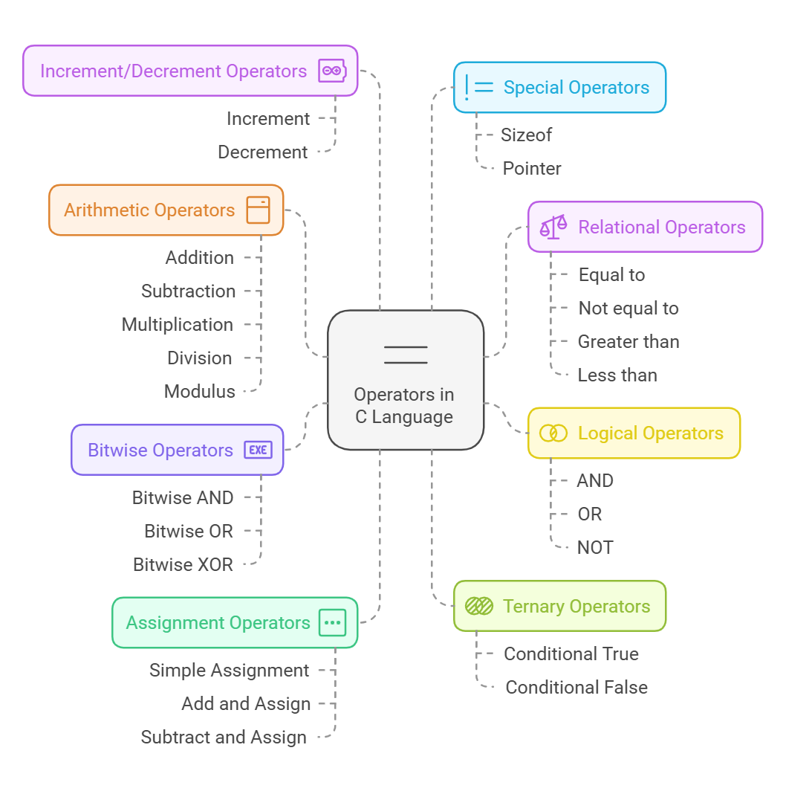
C Operators
Operator is a symbol that is used to perform mathematical or logical manipulations in the program.

Slide 3
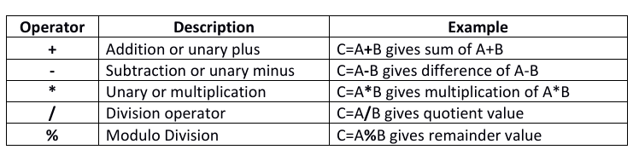
Arithmetic operators
These are used to perform basic mathematical calculations
like addition, subtraction, multiplication, division and modulus operations in an expression.

Slide 4
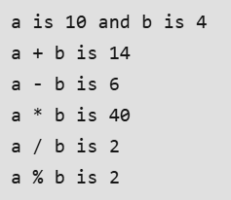
Arithmetic operators
Code
#include <stdio.h>
int main()
{
int a = 10, b = 4, res;
// printing a and b
printf("a is %d and b is %d\n", a, b);
res = a + b; // addition
printf("a + b is %d\n", res);
res = a - b; // subtraction
printf("a - b is %d\n", res);
res = a * b; // multiplication
printf("a * b is %d\n", res);
res = a / b; // division
printf("a / b is %d\n", res);
res = a % b; // modulus
printf("a %% b is %d\n", res);
return 0;
}
Output

Slide 5
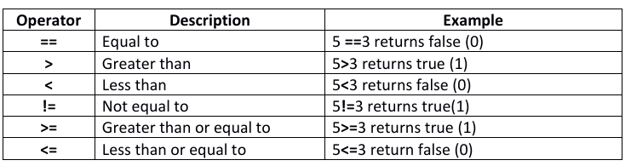
Relational operator
These operators are used to compare the value of two variables
(or) operands.

Slide 6
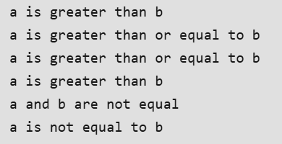
Relational operator
Code
#include <stdio.h>
int main()
{
int a = 10, b = 4;
// greater than example
if (a > b)
printf("a is greater than b\n");
else
printf("a is less than or equal to b\n");
// greater than equal to
if (a >= b)
printf("a is greater than or equal to b\n");
else
printf("a is lesser than b\n");
// less than example
if (a < b)
printf("a is less than b\n");
else
printf("a is greater than or equal to b\n");
// lesser than equal to
if (a <= b)
printf("a is lesser than or equal to b\n");
else
printf("a is greater than b\n");
// equal to
if (a == b)
printf("a is equal to b\n");
else
printf("a and b are not equal\n");
// not equal to
if (a != b)
printf("a is not equal to b\n");
else
printf("a is equal b\n");
return 0;
}
Output

Slide 7
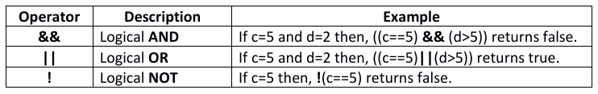
Logical operators
These operators are used to compare two or more relational
expressions.

Slide 8

Logical operators
Code
#include <stdio.h>
int main()
{
int a = 10, b = 20;
if (a > 0 && b > 0) {
printf("Both values are greater than 0\n");
}
else {
printf("Both values are less than 0\n");
}
return 0;
}
Output

Slide 9
Logical operators
Code
#include <stdio.h>
int main()
{
int a = -1, b = 20;
if (a > 0 || b > 0) {
printf("Any one of the given value is "
"greater than 0\n");
}
else {
printf("Both values are less than 0\n");
}
return 0;
}
Output

Slide 10
Logical operators
Code
#include <stdio.h>
int main()
{
int a = 10, b = 20;
if (!(a > 0 && b > 0)) {
// condition returned true but
// logical NOT operator changed
// it to false
printf("Both values are greater than 0\n");
}
else {
printf("Both values are less than 0\n");
}
return 0;
}

Slide 11
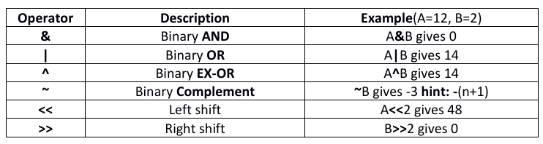
Bitwise (or) binary operators
C has distinction of supporting special operators known as bitwise operators for manipulation of data at bit level. These operators are used for testing the bits and shifting them right to left or left to right.
NOTE
Left shifting one time means, it is equal to multiplying the value by 2 one time.
Right shifting one time means, it is equal to dividing the value by 2 one time.

Slide 12
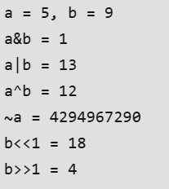
Bitwise (or) binary operators
#include <stdio.h>
int main()
{
// a = 5 (00000101 in 8-bit binary), b = 9 (00001001 in
// 8-bit binary)
unsigned int a = 5, b = 9;
// The result is 00000001
printf("a = %u, b = %u\n", a, b);
printf("a&b = %u\n", a & b);
// The result is 00001101
printf("a|b = %u\n", a | b);
// The result is 00001100
printf("a^b = %u\n", a ^ b);
// The result is 11111111111111111111111111111010
// (assuming 32-bit unsigned int)
printf("~a = %u\n", a = ~a);
// The result is 00010010
printf("b<<1 = %u\n", b << 1);
// The result is 00000100
printf("b>>1 = %u\n", b >> 1);
return 0;
}
Output

Slide 13
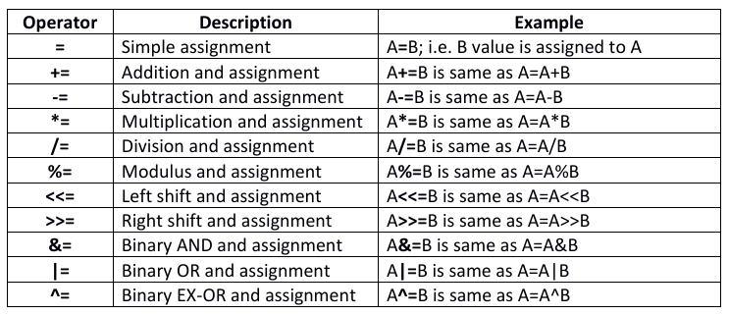
Assignment operators
This operator is used to assign the values for the variables in
the programs.

Slide 14
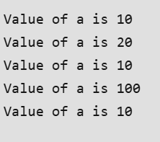
Assignment operators
#include <stdio.h>
int main()
{
// Assigning value 10 to a
// using "=" operator
int a = 10;
printf("Value of a is %d\n", a);
// Assigning value by adding 10 to a
// using "+=" operator
a += 10;
printf("Value of a is %d\n", a);
// Assigning value by subtracting 10 from a
// using "-=" operator
a -= 10;
printf("Value of a is %d\n", a);
// Assigning value by multiplying 10 to a
// using "*=" operator
a *= 10;
printf("Value of a is %d\n", a);
// Assigning value by dividing 10 from a
// using "/=" operator
a /= 10;
printf("Value of a is %d\n", a);
return 0;
}
Output

Slide 15
Ternary operator
The conditional operator contains a condition followed by two conditions or two expressions. Conditional operator takes three operands and consists of two symbols ‘?’ and ‘:’. It is also called as ternary operator, because it takes three arguments.
Syntax: (Condition)? (Expression1): (Expression2);
If the condition is true then expression1 gets evaluated otherwise (i.e. if condition false) expression2 gets evaluated.
Example1: if(10%2==0)?printf(“even number”):printf(“odd number”); //prints even number
Example2: sum=(10>=10)?(100-50):(200-50); // the value of 50 assigned to variable sum.

Slide 16
Ternary operator
#include <stdio.h>
int main()
{
int m = 5, n = 4;
(m > n) ? printf("m is greater than n that is %d > %d",
m, n)
: printf("n is greater than m that is %d > %d",
n, m);
return 0;
}
Output

Slide 17
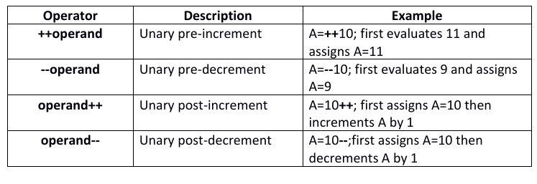
Increment or decrement operators
These operators are used to increment or decrement by 1 in an expression.

Slide 18

Increment or decrement operators
#include <stdio.h>
void increment()
{
int a = 5;
int b = 5;
// PREFIX
int prefix = ++a;
printf("Prefix Increment: %d\n", prefix);
// POSTFIX
int postfix = b++;
printf("Postfix Increment: %d", postfix);
}
// Driver code
int main()
{
increment();
return 0;
}
Output

Slide 19
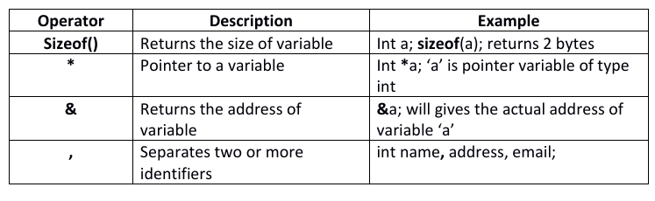
Special operators
C supports some special operators as shown below.

Slide 20
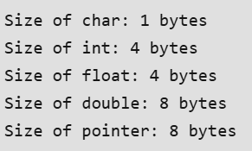
Special operators
#include <stdio.h>
int main(){
printf("Size of char: %lu bytes\n", sizeof(char));
printf("Size of int: %lu bytes\n", sizeof(int));
printf("Size of float: %lu bytes\n", sizeof(float));
printf("Size of double: %lu bytes\n", sizeof(double));
printf("Size of pointer: %lu bytes\n", sizeof(void *));
return 0;
}
Output

Slide 21
Operators Precedence and Associativity
Precedence and Associativity are the two characteristics of operators that determine the evolution order of sub expressions in absence of brackets.
Operators precedence determines, which operators action is to be perform first in an expression containing more than one operator. For example, 10+20*30 is calculated as 10+ (20*30) and not as (10+20)*30.
Associativity is used when two or more operators of same precedence operators appeared in an expression. Associativity can be either left to right or right to left. For example, 100/10*10 is calculated as (100/10)*10 not as 100/ (10*10), due having the same precedence of operators (/, *).

Slide 22
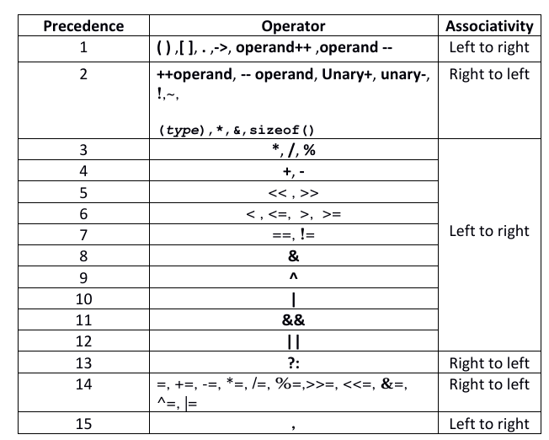
Operators Precedence and Associativity

Slide 23

Operators Precedence and Associativity
#include <stdio.h>
int main() {
int a = 6, b = 3, c = 4;
int res;
// Precedence and associativity applied here
res = a + b * c / 2;
printf("%d", res);
return 0;
}
Output

Slide 24
MCQs
Q1. Which of the following is true?
gets() doesn't do any array bound testing and should not be used.
fgets() should be used in place of gets() only for files, otherwise gets() is fine
gets() cannot read strings with spaces
None of the above
Explanation
Use of gets() generates the risk of an overflow of the allocated buffer. This happens because the function gets(), doesn't know the size of the buffer, and continues reading until it finds a newline "n" or encounters EOF, and so it may overflow the bounds of the buffer it was given.
Q2. Predict the output?
int fun(char *str1)
{
char *str2 = str1;
while (*++str1)
;
return (str1 - str2);
}
int main()
{
char *str = “AbcdeQuiz";
printf("%d", fun(str));
return 0;
}
10
9
8
Random Number
Explanation
The function fun() basically counts number of characters in input string.
Inside fun(), pointer str2 is initialized as str1. The statement while(*++str1);
increments str1 till ‘\\0’ is reached. str1 is incremented by 9.
Finally the difference between str2 and str1 is returned which is 9.

Slide 25
MCQs
Q3. Given that x = 7.5, j = -1.0, n = 1.0, m = 2.0 the value of - - x + j == x>n> = m is:
0
1
2
3
Explanation
- - x + j == x > n >= m 6.5 + (-1.0) == 6.5 > 1.0 >= 2.0 5.5 == 1 > = 2.0 3.5 == 0 Which is not true, i.e. false(0).

Slide 26
MCQs
Q4. If n has 3, then the statement a[++n]=n++;
assigns 3 to a[5]
assigns 4 to a[5]
assigns 4 to a[4]
what is assigned is compiler dependent
Q5.
#include <stdio.h>
int main()
{
int i = 3;
printf("%d", (++i)++);
return 0;
}
3
4
5
Compile-time error
Explanation
In C, prefix and postfix operators need l-value to perform operation and return r-value. The expression (++i)++ when executed increments the value of variable i(i is a l-value) and returns r-value. The compiler generates the error(l-value required) when it tries to post-incremeny the value of a r-value.

Slide 27
Thank
You!

